Slide 1

Chapter No. 8 The Search for Entrepreneurial Capital

Slide 2
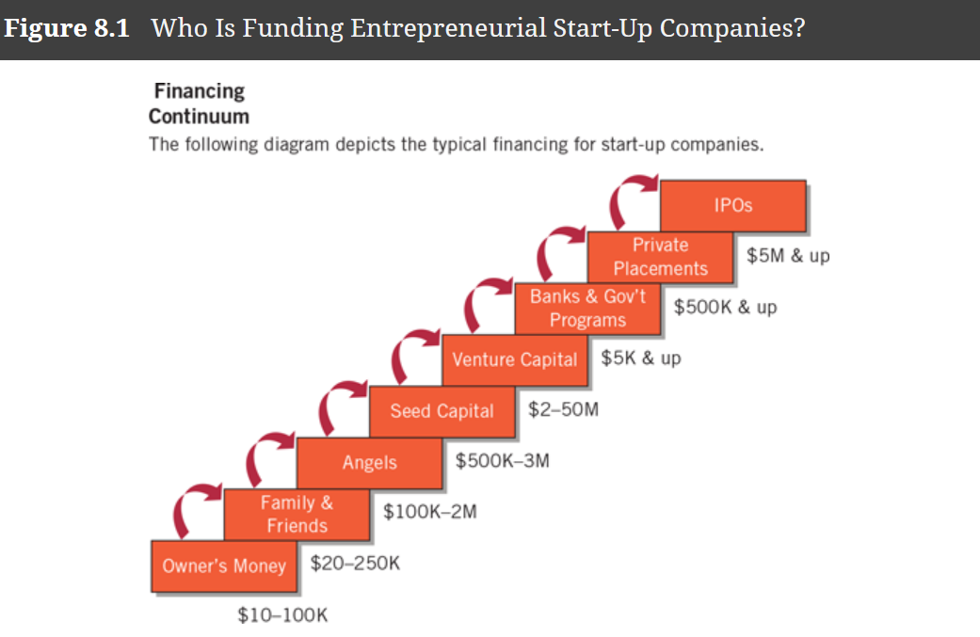

Slide 3


Slide 4
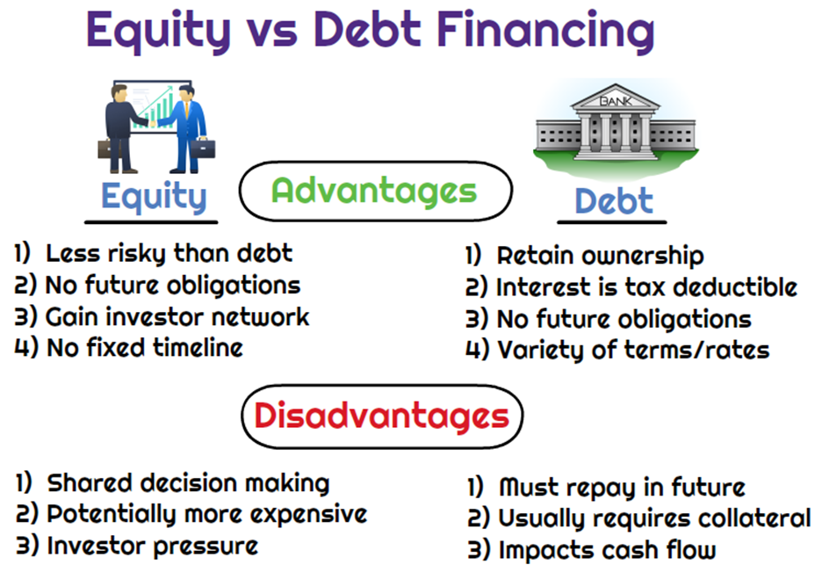

Slide 5


Slide 6
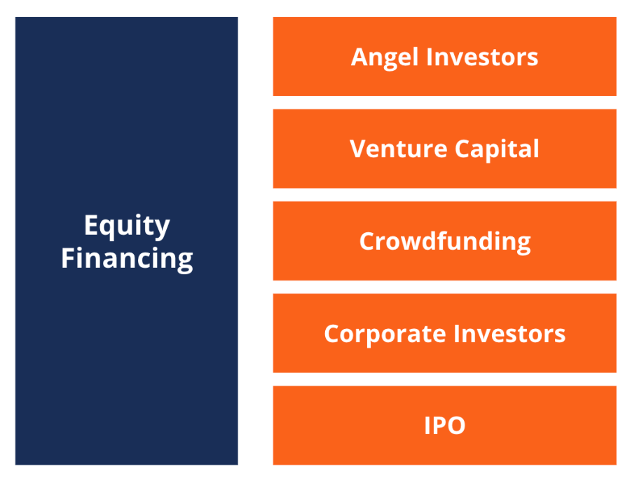
Sources of Equity Financing
Sources of Debt Financing
Commercial banks.
Finance companies.
Leasing companies.
Insurance companies.

Slide 7

Type of equity financing

Slide 8
Advantages of public offerings
Size of capital amount.
Liquidity.
Value.
Image.

Slide 9
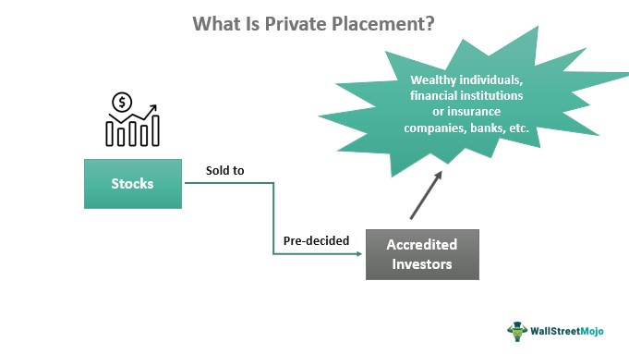

Type of equity financing (private placement)

Slide 10

Type of equity financing (venture capital)

Slide 11
Criteria for evaluating new venture proposals
Timing of entry.
Key success factor stability.
Educational capability.
Competitive rivalry.

Slide 12
Evaluation Process Evaluating new venture proposals
Stage 1 : Initial screening.
Stage 2 : Evaluation of a business plan.
Stage 3 : Oral Presentation.
Stage 4 : Final Evaluation

Slide 13
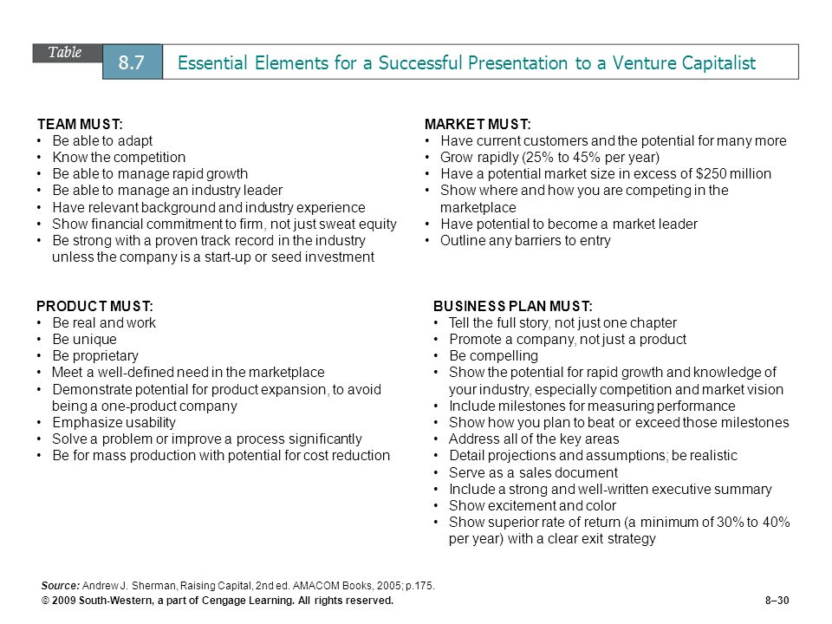

Slide 14
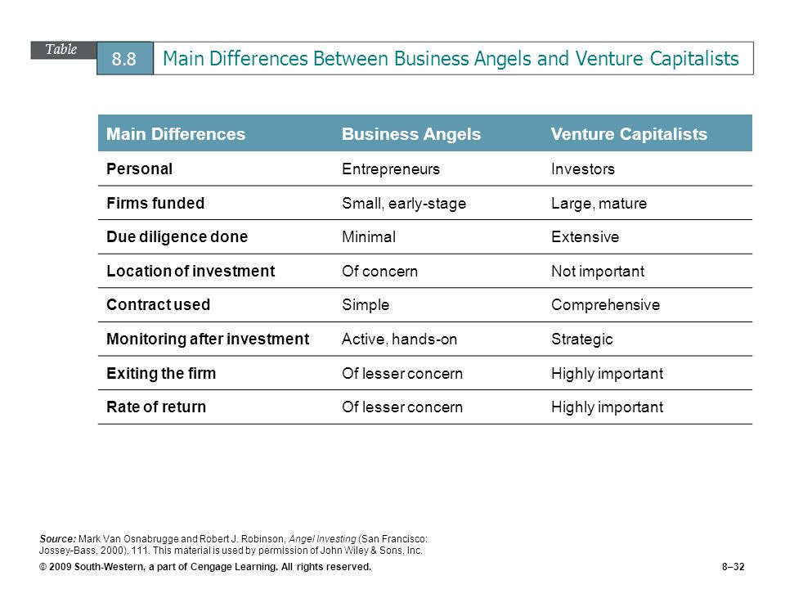

Slide 15


Slide 16
Types of angel investors
Corporate angels.
Highly experienced professionals (early retirement). Here occupy senior management positions.
Entrepreneurial angels.
Mostly they own and operate highly successful companies.
Enthusiast angels
They typically play no role in management. Investing is their hobby.
Micromanagement angels
Demand a seat on the board of directors.
Professional angels.
Invest in companies that offer a product or service with which they have some experience.

Slide 17


